Slide 1
Datapath and its understanding – mips – computer architecture – Session – 10
Shriram K Vasudevan

Slide 2
Agenda
What a data path is all about?
Major elements in the data path.
Building a simple datapath for instructions.
Branching and related hardware requirements for datapath.
Building a comprehensive datapath.
Tracing the datapath for instructions from the comprehensive datapath

Slide 3
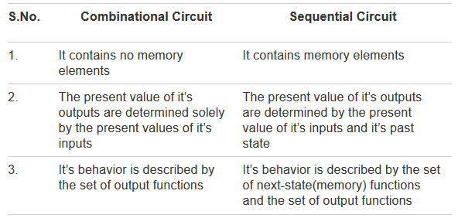
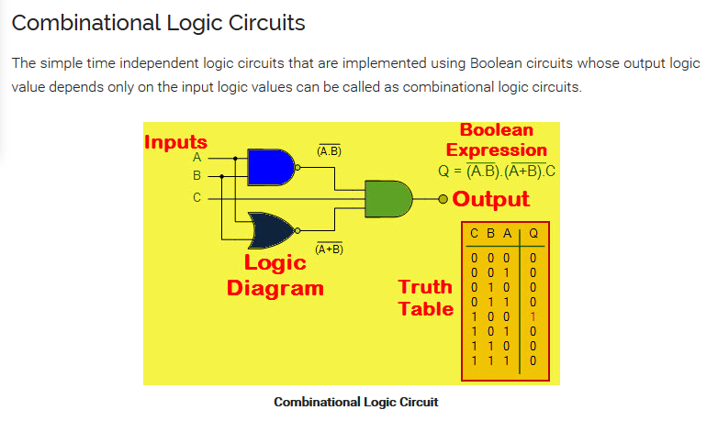
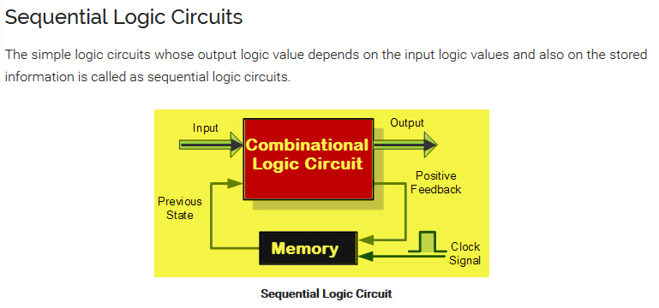
Remember this – a must

Slide 4
Contd.,
A state element has at least two inputs and one output.
The required inputs are the data value to be written into the element and the clock, which determines when the data value is written.
The output from a state element provides the value that was written in an earlier clock cycle
Example for a state element? – D – Flip-flop. Two inputs (a value and a clock) with exactly one output.
In addition to flip-flops, our MIPS implementation also uses two other types of state elements: memories and registers, both of which appear in architecture.
Note: The clock is used to determine when the state element should be written; a state element can be read at any time.

Slide 5
Introduction
Let’s learn the basic terminologies, first!
A data path element is a unit (hardware component) which shall be helpful in holding the data.
The data could be the one which has to be processed or could have been already processed.
Either case, the data requires a place to stay and that is what we mean as data path element.
Some of the data path elements could be memory elements to hold the instruction or data, ALU, registers, buses, adders, multiplexors etc. (I ignore control signals for now, we shall deal it later)

Slide 6
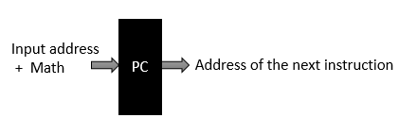
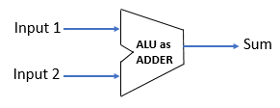
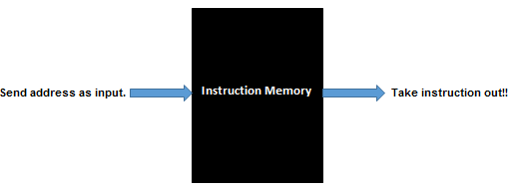
Datapath elements
Adder
Program Counter
Instruction Memory
There are more components like multiplexors and control signals to be learnt; We shall introduce them as and when needed appropriately.
Now, it would be good to get a shape with all the datapath elements available in hand. Just to reiterate,
Program counter is used to store the address of next instruction.
Adder helps in incrementing the address in the program counter so as to make it hold the address of next instruction.
Instruction memory holds all the instructions and with the input from the program counter, one can identify the instructions one after another.

Slide 7
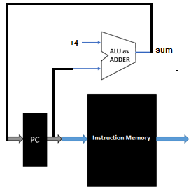
Let us connect all the three..

Slide 8
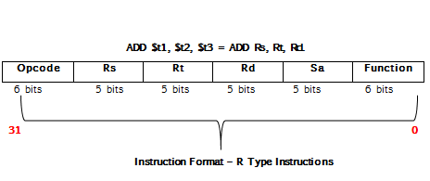
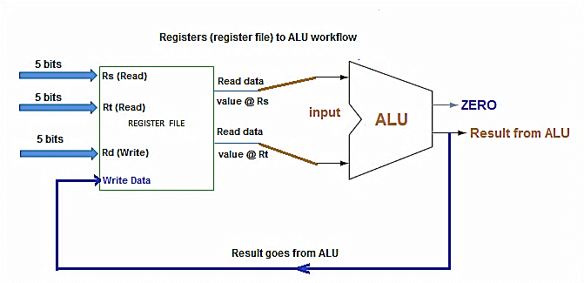
Datapath for ADD/SUB instruction (R – Type)

Slide 9
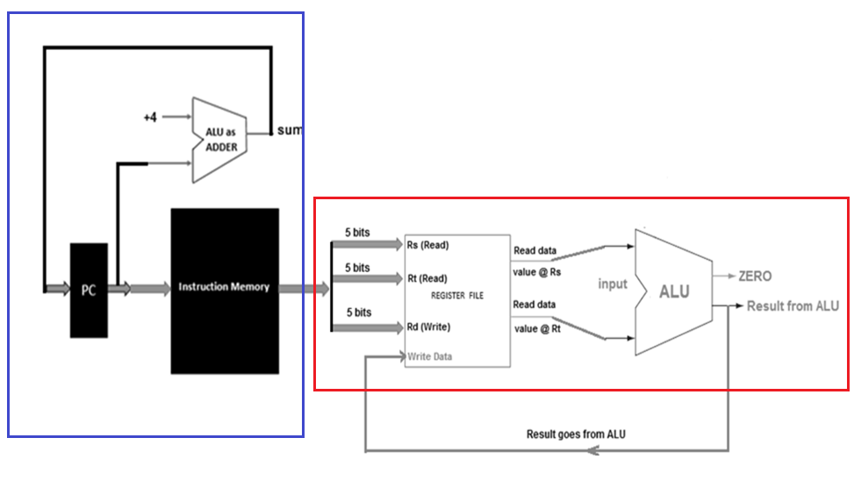
Contd.,
Datapath representation for ADD instruction

Slide 10
Load Word (LW)
lw $Rt, offset ($Rs)
lw $to, 15 ($t1)
Assuming t1 has the content 100 and offset as specified is 15, lw computes the sum as 100 + 15 = 115.
115 is the location is which has the data to be loaded to the register t0. Content from the location from 115 shall be now copied to $to.

Slide 11
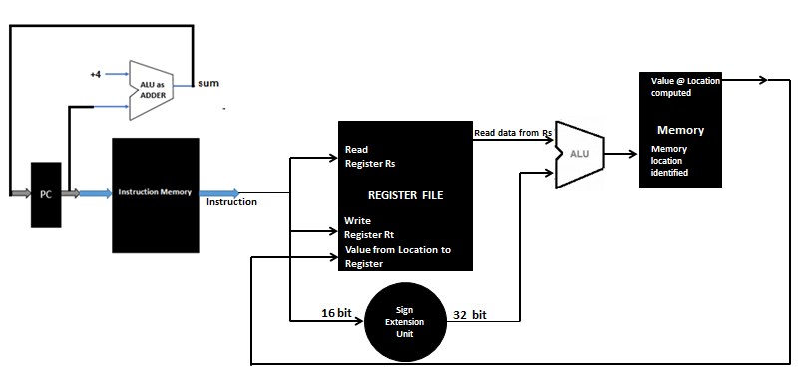
Contd.,
Datapath representation for Load instruction

Slide 12
Contd.,
Understand this!
Offset is present in the instruction and is 16 bit wide. It has to be converted to 32 bits and sign extension unit is used for the purpose. Eg. lw $to, 15 ($t1)
The register which has the value (in concurrence with the offset) is identified as Rs and the data from Rs is read.
The Rs data and offset value together gets the result (e.g. 15 from offset and 100 from Rs = 115). 115 is the memory location to be checked for the data to be loaded into the destination register.
From the location computed the data shall be fetched (retrieved) and loaded into the register specified in the instruction. This is represented in the datapath representation.

Slide 13
Datapath for Storeword (SW)
SW is complementary for LW. Store word works this way. (SW $Rt, Offset ($Rs))
The content from a register specified should be loaded into a memory location.
The memory location shall be computed with the offset + register content (As in case of LW). ALU sums up and gets the location to which the content from the source register has to be stored.
Once memory location is identified, the value at Rt shall be stored in the location.

Slide 14
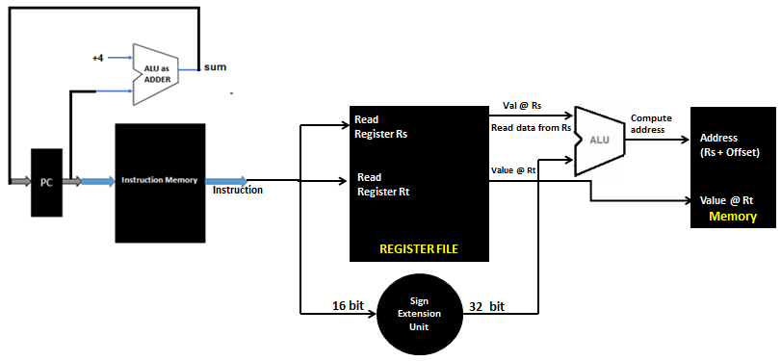
So we draw as this!
Datapath for Storeword (SW)

Slide 15
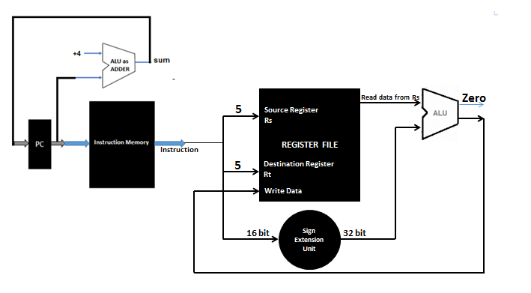
Datapath for Immediate Instruction
Instruction format: addi $Rs, $Rt, Offset
Sample Instruction: addi $t0, $t0, 5 ($t0 = $t0 + 5)

Slide 16
Lets make it complicated!
Single datapath – An approach to be appreciated.
Can’t have multiple datapaths for multiple instructions.
Cost would be more.
Complexity would be fairly high!
So, a single datapath should support all the instructions!
LET US SEE THAT IN NEXT SESSION!!! ☺
THANK YOU
SHRIRAM K VASUDEVAN

Slide 17
Datapath and its understanding – mips – computer architecture – Session – 11
Shriram K Vasudevan

Slide 18
Single datapath – An appreciable approach
Multiplexors needed! No other go!
Signals – We shall explain later! But, know the names.
RegWrite – Register Write Signal.
ALUSRC – ALU source.
MemRead – Memory Read.
MemWrite – Memory Write.
MemtoReg – Memory to Register.

Slide 19
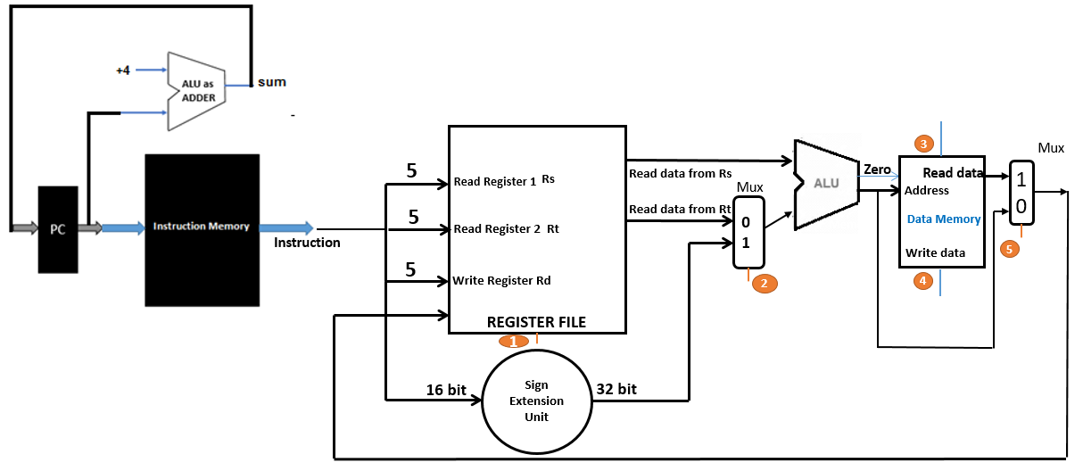
Let us see the versatile datapath!!!
RegWrite – Register Write Signal.
ALUSRC – ALU source.
MemRead – Memory Read.
MemWrite – Memory Write.
MemtoReg – Memory to Register.

Slide 20
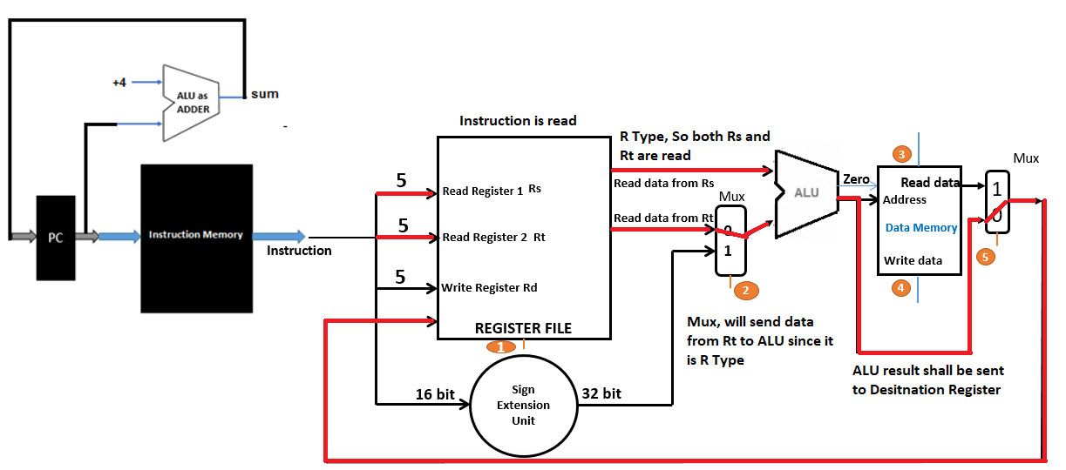
Now starts fun! Lets trace the path!
Tracing R Type (ADD Instruction, for an instance)
R TYPE (ADD) FROM DATAPATH

Slide 21
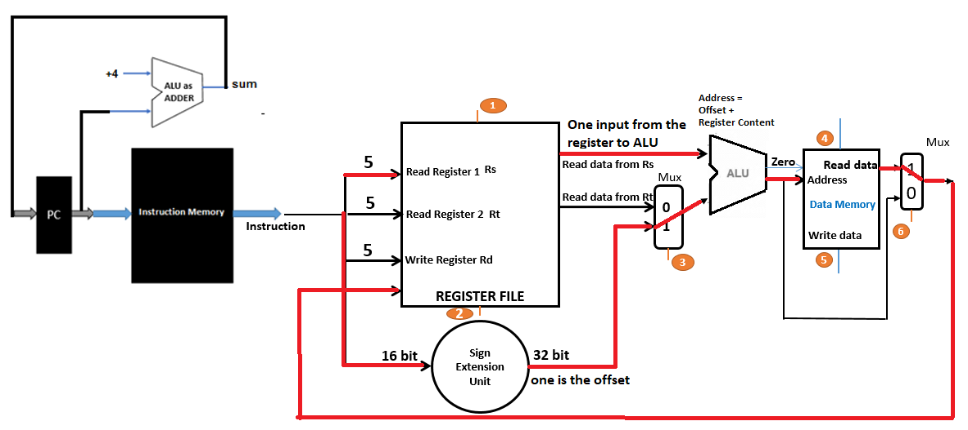
Tracing LW from the versatile datapath
LW TRACE FROM DATAPATH
Data path and Branching ! Lets see in the next session, Thank You

Slide 22
Datapath and its understanding – mips – computer architecture – Session – 3
Shriram K Vasudevan

Slide 23
Branching! – A tough zone!
The instruction to be analyzed is BEQ for establishing a basic understanding about branching operation.
BEQ is expanded as branch if equal.
So, the story is simple.
Two registers are to be compared. There would be an offset made available as part of instruction and it shall help in computing target address to which the branch has to be taken. It also becomes important to understand if the branching would be taken or would the execution be sequential?
So, the challenges are
Compute the branch target address.
Identify if the branching is really taken or not.

Slide 24
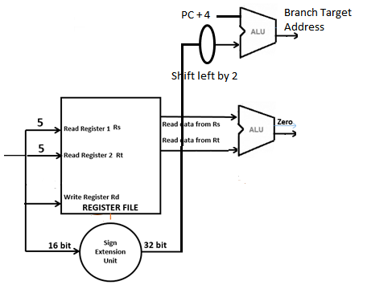
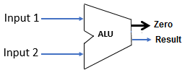
See this!

Slide 25
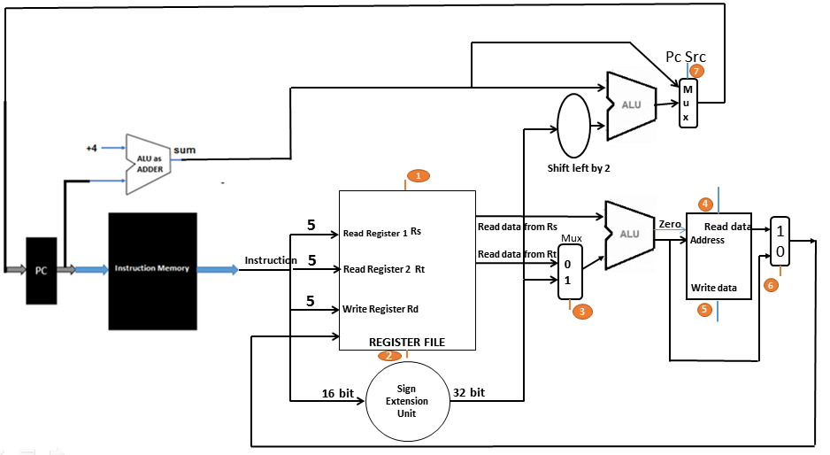
A Complex Datapath With Branching Support!!!!

Slide 26
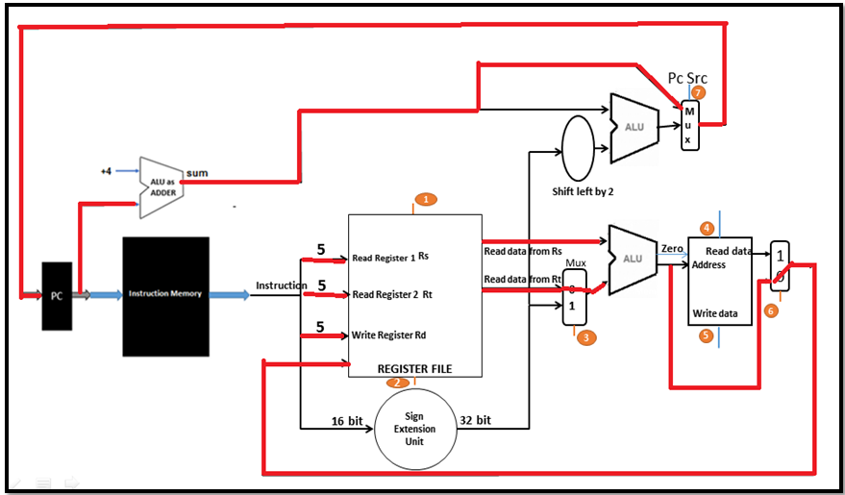
Tracing the data path for ADD instruction

Slide 27
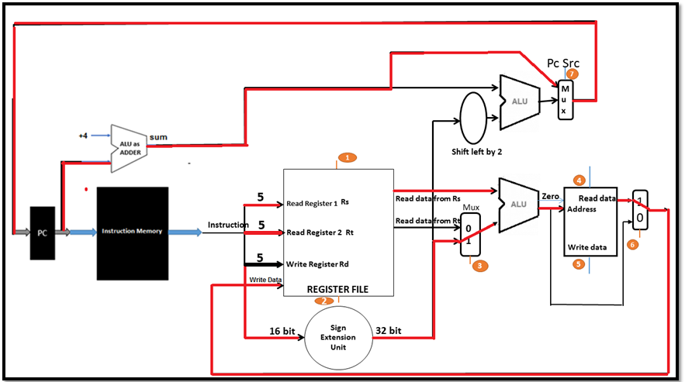
Tracing the data path for LW instruction

Slide 28
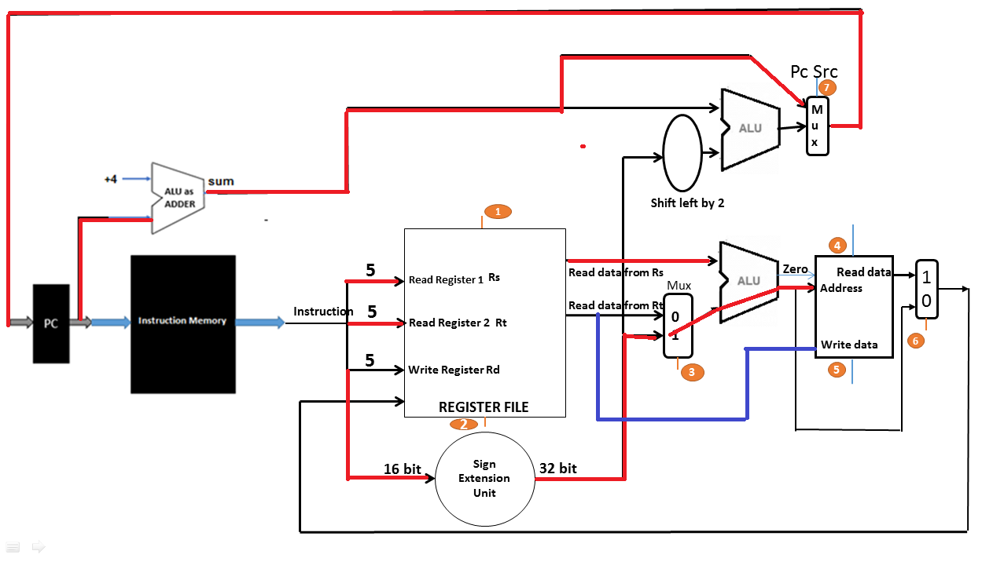
Tracing the data path for SW instruction

Slide 29
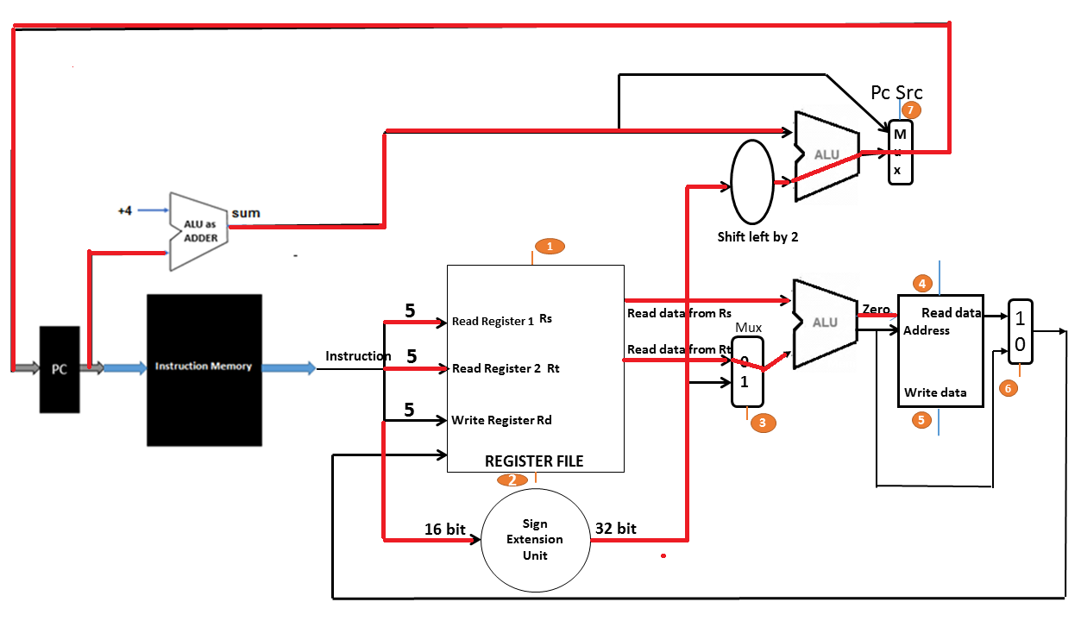
Tracing the data path for Branching instruction (BEQ path trace)

Slide 30
LET US SEE THAT IN NEXT SESSION!!! ☺
THANK YOU
SHRIRAM K VASUDEVAN

